Slide 1
Computer Organization & Assembly Language (CSC-236)
Lecture 17

Slide 2
5.4. SAVING AND RESTORING REGISTERS
Why Save Registers in Subroutines?
Subroutines sometimes change (or destroy) values in registers
This causes problems if the main program needs those values later
We can’t remember which subroutine changes which register all the time
Solution: Use PUSH to save register values and POP to get them back.

Slide 3
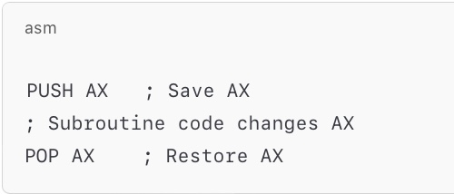
5.4. SAVING AND RESTORING REGISTERS
PUSH & POP to the Rescue!
Before changing a register ➡️ PUSH it (save it on the stack)
After subroutine work is done ➡️ POP it (get it back from the stack)
This way, the subroutine doesn’t mess up the main program

Slide 4
What is the output of this?
PUSH AX
MOV AX, 5
PUSH AX
POP AX

Slide 5
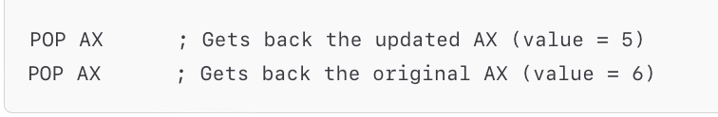
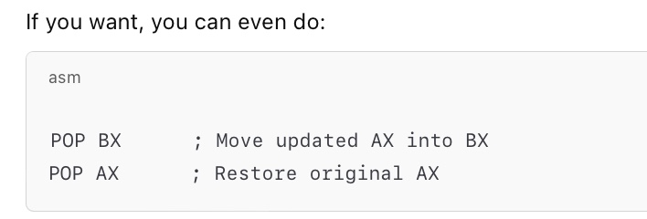
Example
MOV AX, 6
PUSH AX
MOV AX, 5
PUSH AX ; Return 5
POP AX ; Return 6

Slide 6
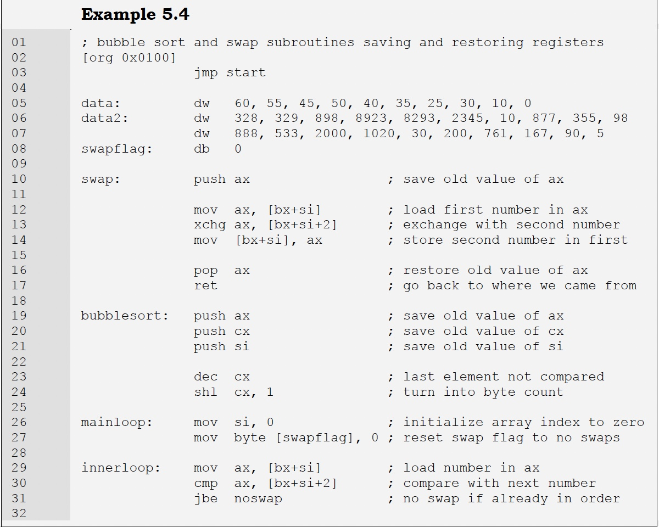
Example - 5.4

Slide 7
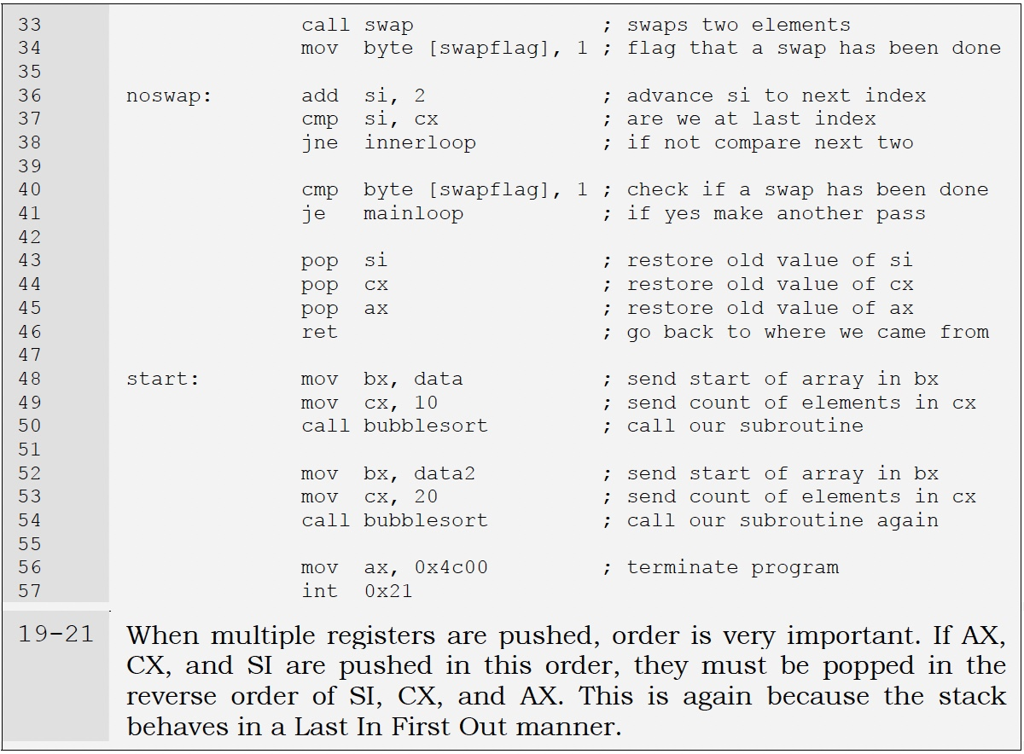
Example : 5.4

Slide 8
5.4. SAVING AND RESTORING REGISTERS
Observing Register Behavior with CALL, PUSH, and POP
Inside a debugger, registers look unchanged before and after a CALL
Why? Because the subroutine saves registers using PUSH and restores them using POP
This is standard practice — every well-written subroutine should do this
PUSH stores values on the stack + POP retrieves them
This makes subroutines safe — they don’t disturb the caller’s data

Slide 9
5.4. SAVING AND RESTORING REGISTERS
How PUSH and POP Work?
PUSH:
Decreases SP (stack pointer) by 2
Moves a word from the source operand (e.g., AX) onto the stack
Often used to:
Save register values
Pass parameters to subroutines
Store temporary data
POP:
Moves a word from the top of the stack to the destination operand
Increases SP by 2 (to remove that item from the stack)
Often used to:
Restore register values
Retrieve parameters or temporary variables

Slide 10
5.4. SAVING AND RESTORING REGISTERS
CALL Instruction – Near vs Far
CALL starts an out-of-line procedure (a subroutine)
It saves return information on the stack, allowing RET to bring
control back
Near CALL (Intra-Segment Call):
Procedure is in the same segment
SP is decremented by 2
IP (Instruction Pointer) is pushed onto the stack
Also called "Near Call".
FAR CALL (Inter-Segment Call):
Procedure is in a different segment
SP is decremented by 2, and CS is pushed
Then SP is decremented by 2 again, and IP is pushed
CS and IP are updated with the segment and offset of the target procedure
Also called "Far Call"

Slide 11
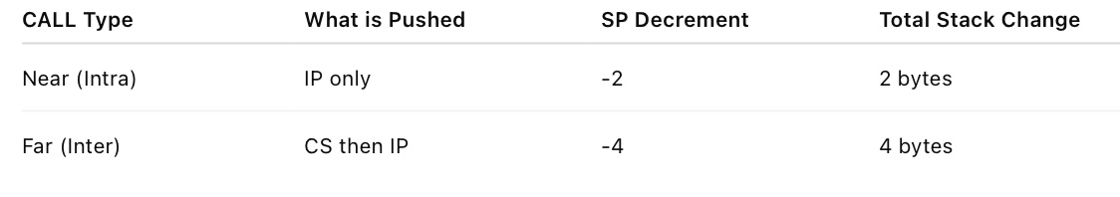
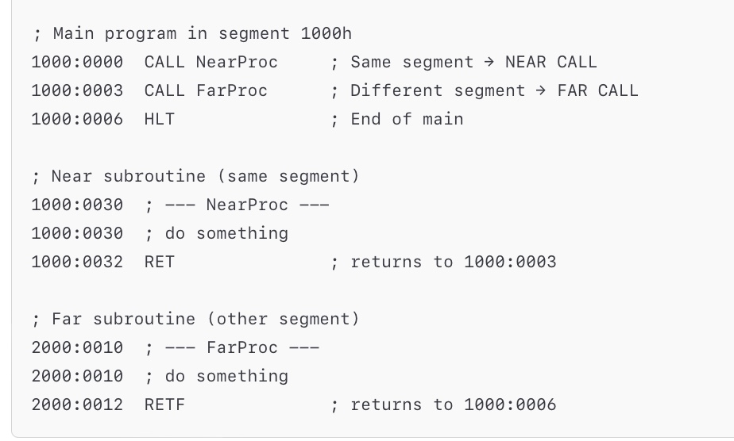
5.4. SAVING AND RESTORING REGISTERS

Slide 12
5.4. SAVING AND RESTORING REGISTERS
Q: What is the difference between RET and RETF ?

Slide 13
5.4. SAVING AND RESTORING REGISTERS
Q: What is the difference between RET and RETF ?
The difference between RET and RETF is directly tied to the type of
CALL used — NEAR or FAR.
RET = Return from NEAR CALL
When the procedure was called using CALL (near)
The subroutine is in the same code segment
What it does?
Pops 2 bytes from the stack into IP
CS is NOT changed

Slide 14
5.4. SAVING AND RESTORING REGISTERS
Q: What is the difference between RET and RETF ?
The difference between RET and RETF is directly tied to the type of
CALL used — NEAR or FAR.
RETF = Return from FAR CALL
When the procedure was called using CALL FAR
The subroutine is in a different segment
What it does?
Pops 2 bytes into IP (offset)
Pops 2 more bytes into CS (segment)
So it restores both IP and CS → full address

Slide 15
Announcement
As announced earlier, there will be a quiz 4 in your next class, i.e., 21-May-2025
Syllabus includes : Lecture no 14, 15, 16 (Q.no: 1,2,4,5,9), 17
Quiz Type: 3 short questions + 1 programming question

Slide 16
End of Lecture

